Slide 1


Slide 2

You want to hack the Mexican government
You receive an e-mail on your inbox.

Slide 3
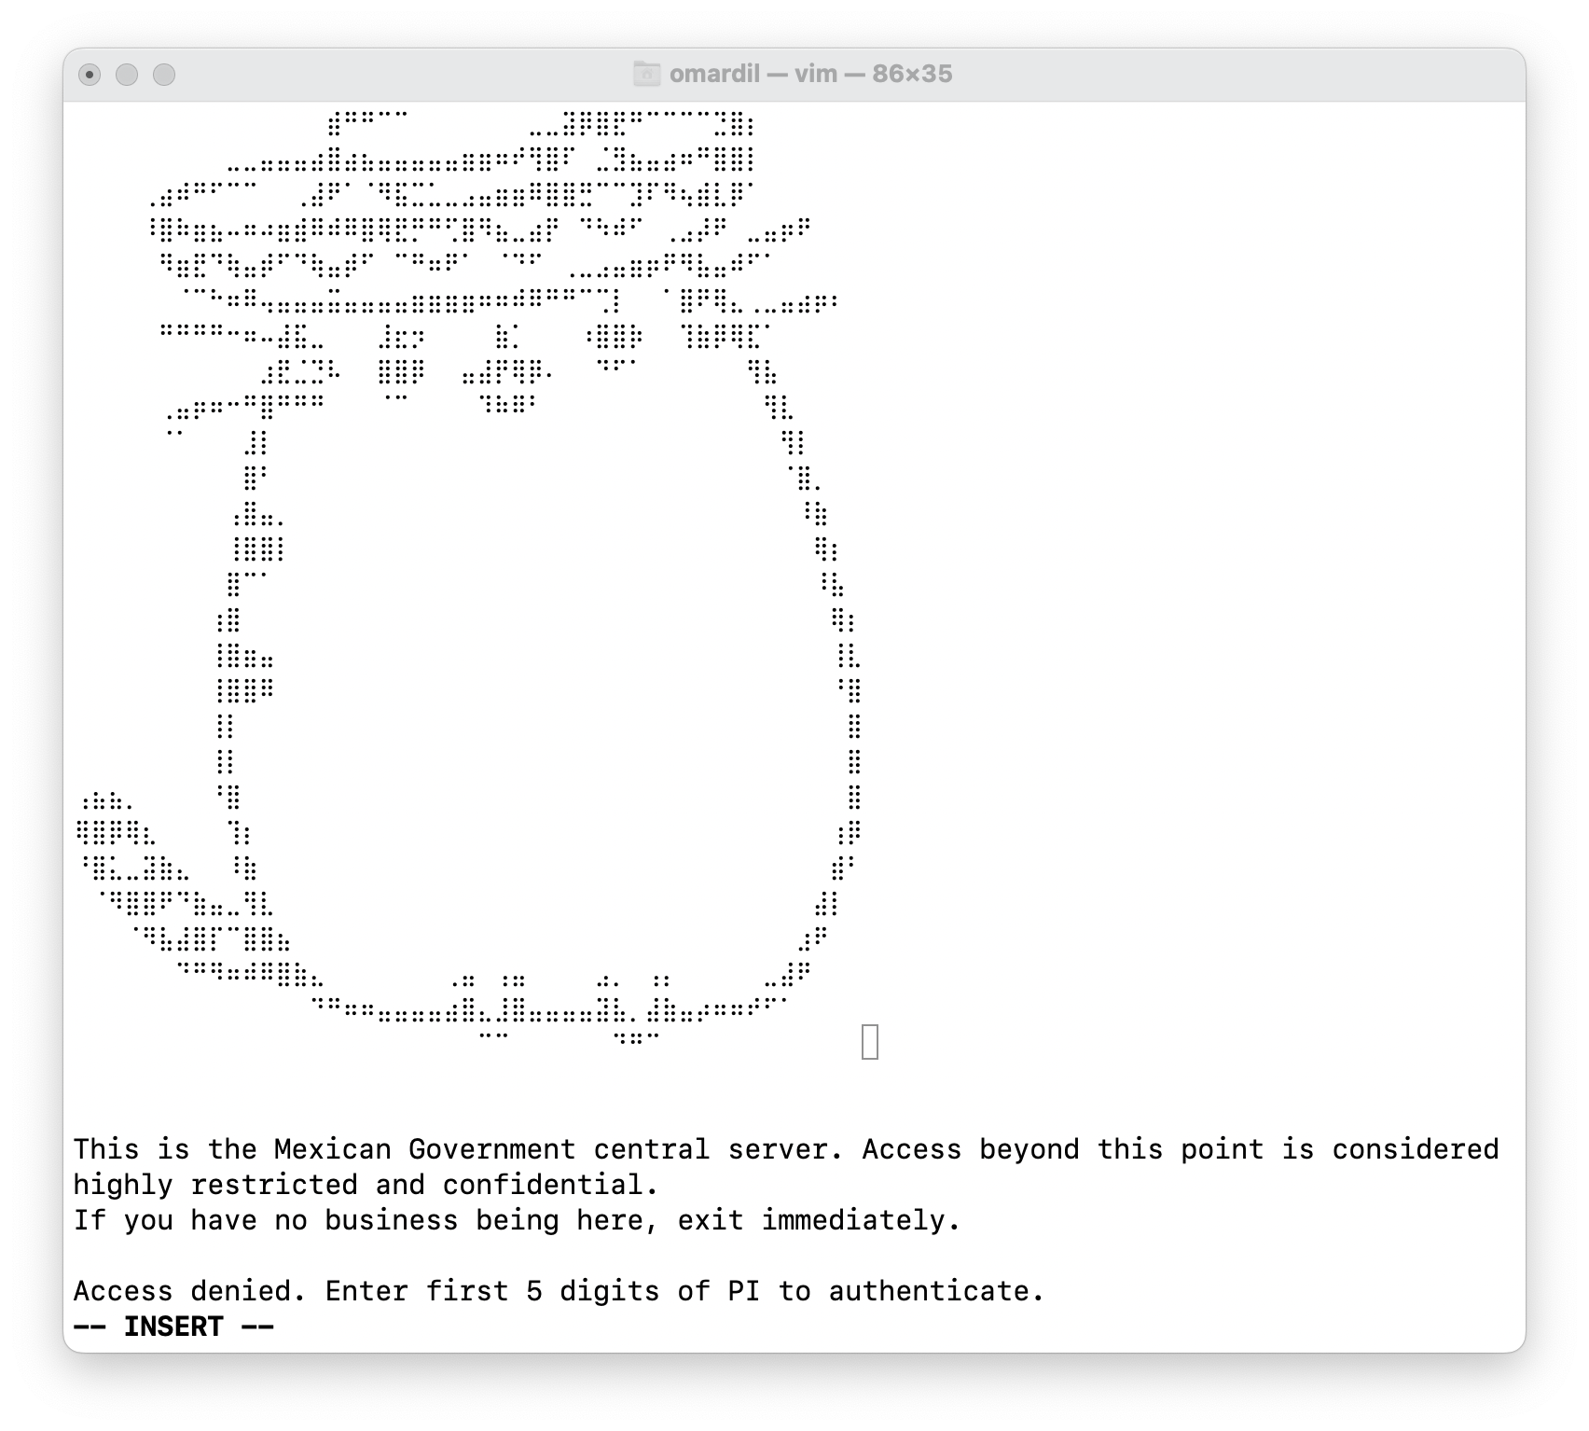
You logon into the server.

Slide 4

You remember that you can use the Leibnz formula to approximate the first 8 values for PI.

Slide 5
Design a method that prints the value of PI, calculating it with a precision of 10000 elements of the Leinbz series.

Slide 6
